Slide 1
LFEV Project: Physics Modeling and Cruise Control
Zainab Hussein
May 3, 2017

Slide 2
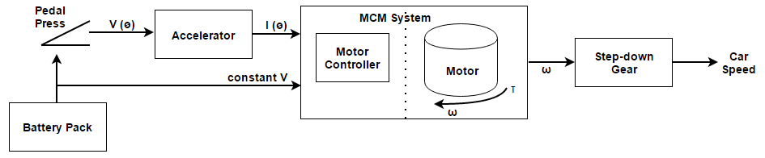
Physical Integration of LFEV
Two approach types:
Physical model
Considers parameters with physical meaning, i.e. load torque, motor speed and supply current
User (driver) controlled model
Considers parameters the driver can access in situ, i.e. throttle controlled by pedal press

Slide 3
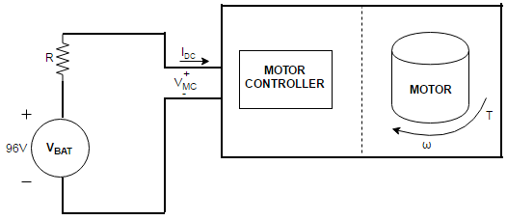
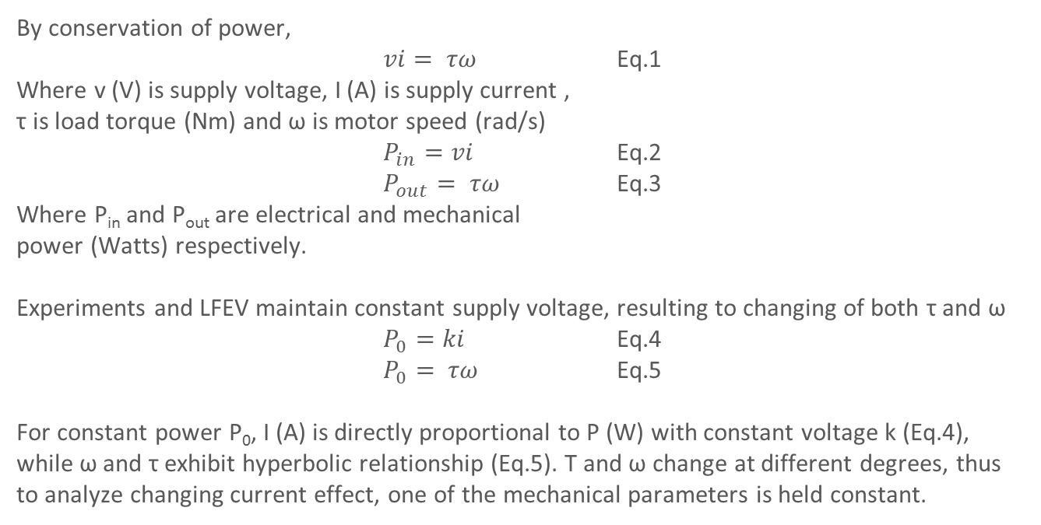
Mathematical Relation of MCM I/O
By conservation of power,
$vi= τω$ Eq.1
Where v (V) is supply voltage, I (A) is supply current ,
τ is load torque (Nm) and ω is motor speed (rad/s)
$P_{in}=vi$ Eq.2
$P_{out}= τω$ Eq.3
Where P_{in} and P_{out} are electrical and mechanical
power (Watts) respectively.
Experiments and LFEV maintain constant supply voltage, resulting to changing of both τ and ω
$P_{0}=ki$ Eq.4
$P_{0}= τω$ Eq.5
For constant power P₀, I (A) is directly proportional to P (W) with constant voltage k (Eq.4), while ω and τ exhibit hyperbolic relationship (Eq.5). Τ and ω change at different degrees, thus to analyze changing current effect, one of the mechanical parameters is held constant.

Slide 4
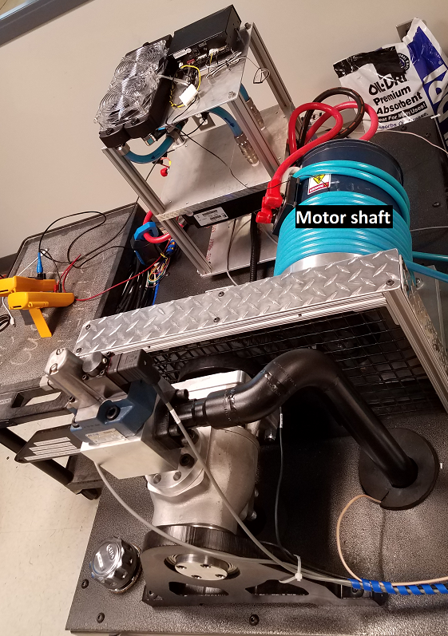
Experimental setup
Dyno setup pseudo LFEV from which Physics Modeling data was collected remotely through a CAN bus.

Slide 5
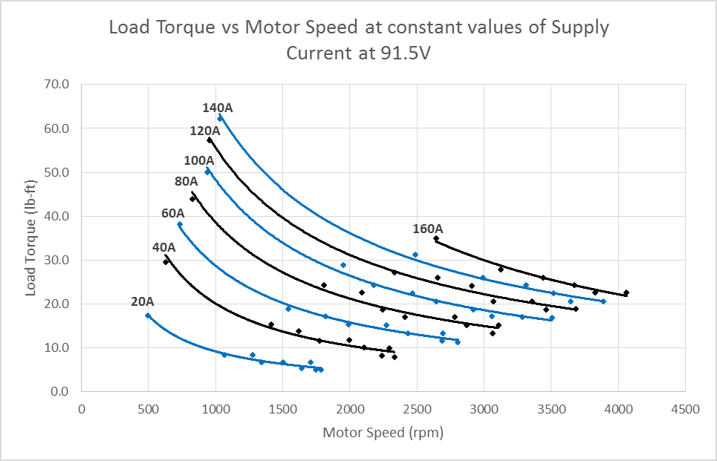
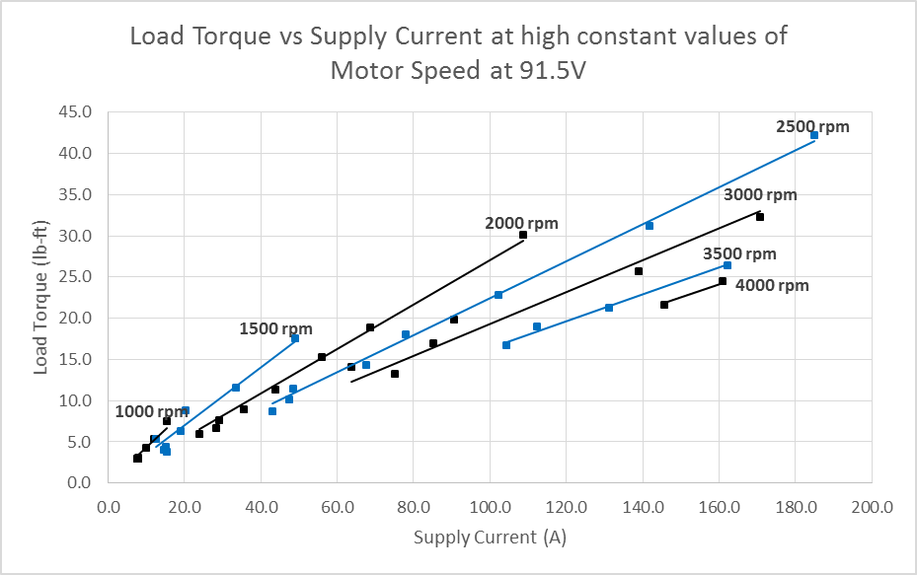
Electric Motor Plausibility for LFEV
At constant motor speed, a set increase in load torque results to an increase in supply current to maintain the given constant motor speed.
At constant current, motor speed self-adjusts at a set load torque value to meet the power which the current is proportional to, resulting in hyperbolic relationship

Slide 6
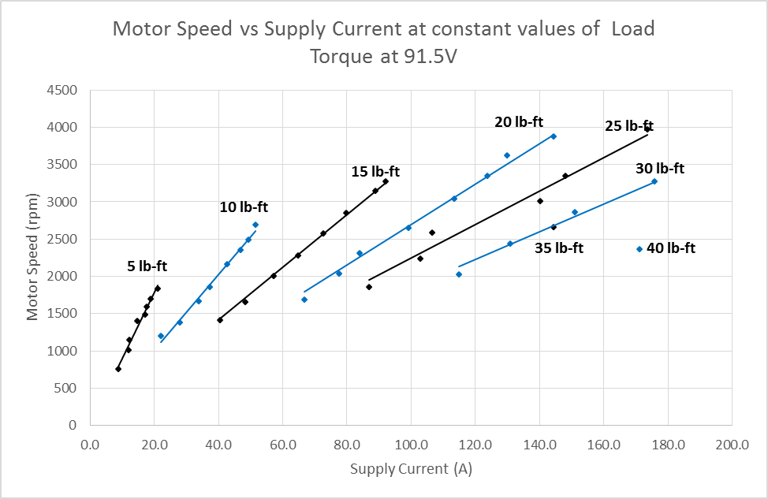
Electric Motor Plausibility for LFEV
Physical Parameter | Working Range
Load Torque (lb-ft) | 0 – 70
Motor Speed (rpm) | 0 - 4000
Supply Current (A) | 0 – 185 (limited by PS)
At constant load torque, a set increase in motor speed results to an increase in supply current to maintain the given constant load torque.

Slide 7
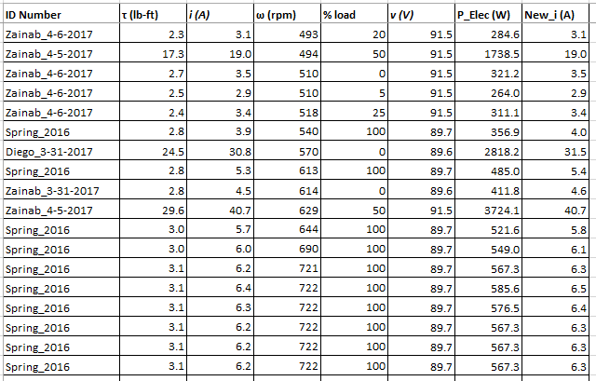
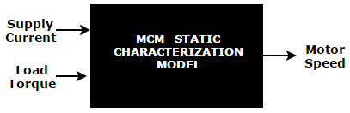
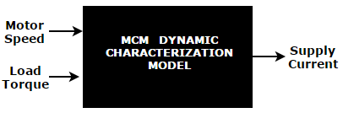
Dynamic and Static Model Lookup Table
Sample section of the lookup table specific to the HPEVS AC50­51­5X Motor ­used for the LFEV

Slide 8
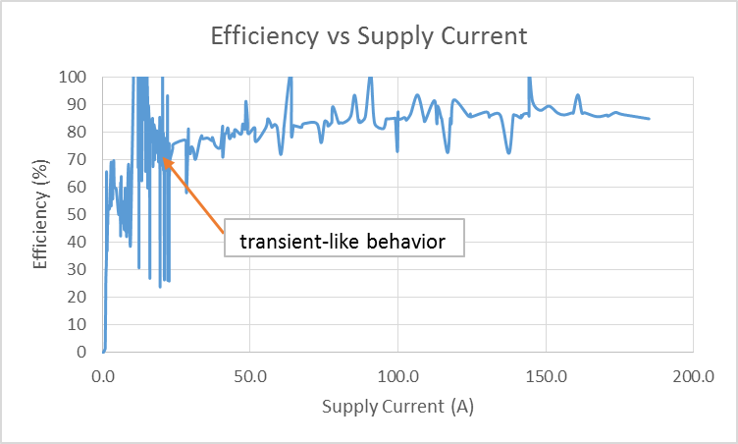
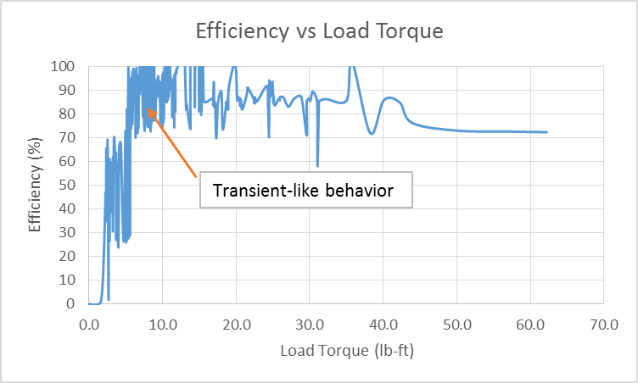
MCM Efficiency

Slide 9
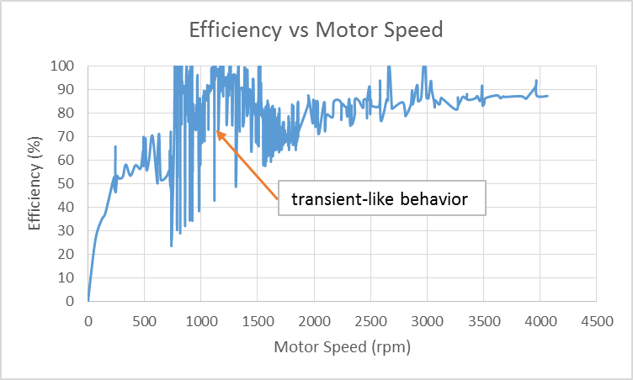
MCM Efficiency
Transient-like behavior possibly caused by:
Motor unstable at the given physical parameter low range
Working range of motor specified excluding the transient.
Data for plot is from all combined data collected.
Experimental data collected in spring ‘17 had irregularities cleaned. Spring ‘16 used as raw (no documented irregularities for data collection)

Slide 10
Conclusion
Observed throttle (physically represented by pedal press) translation to supply current as direct proportionality.
Determined electric motor plausibility for LFEV
Accurate Physics model a good foundation for cruise control
Future Work
Cruise control Simulink simulation building from the physics model

